Slide 1
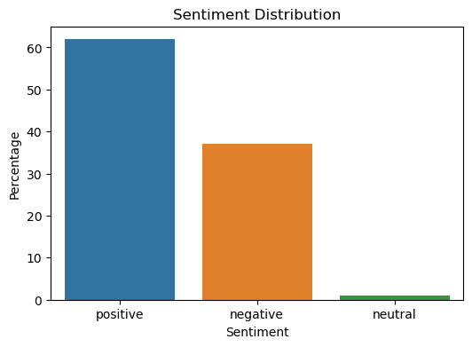
BRITISH AIRWAYS CUSTOMER REVIEW ANALYSIS
Key Insights
Frequent Mentions:
Flight and Service: Customers frequently mention "flight" and "service," indicating these are significant aspects of their experience.
Airline Names: "BA" (British Airways) and "British Airways" appear often, focusing on the airline itself.
Positive Aspects:
Business Class: Mentions of "business" and "class" suggest interest in the premium experience.
Good Service: Words like "good" and "crew" indicate positive experiences with staff and service quality.
Areas for Improvement:
Seating and Comfort: Frequent mentions of "seat" and "seats" point to potential concerns or priorities in seating arrangements.
Recommendations
Enhance Customer Experience: Focus on improving seating comfort and ensuring consistent service quality.
Promote Business Class: Highlight positive reviews and features of the business class to attract more premium travelers.

